Slide 1
Performance Matters/Unify Student Access Online Testing, Reporting, Resources
Helping students take ownership of learning.

Slide 2
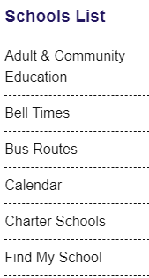
School District Website
Go to the Palm Beach County Schools website
The link is here:
Click District
https://www.palmbeachschools.org/
Then click on Charter Schools

Slide 3
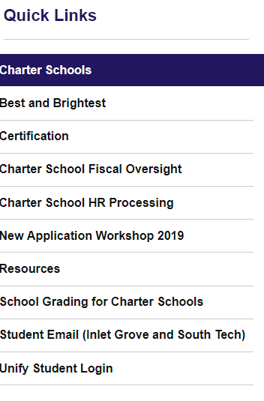
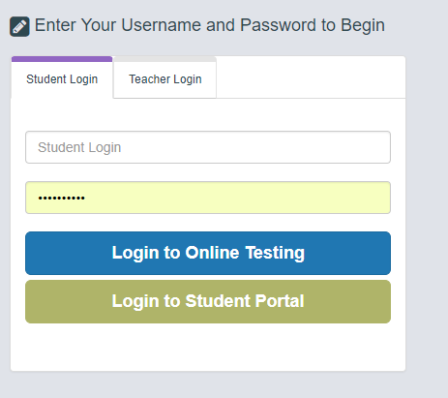
Unify Website
Click on Unify Student Login
Then this box will pop up

Slide 4
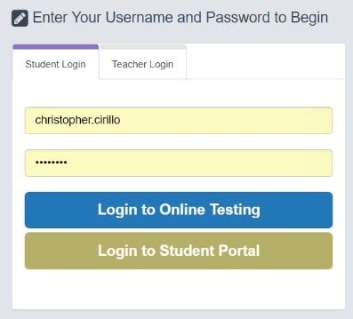
Performance Matters Login Landing Page – Online Testing
Students will have two access options to enter the “Login to Online Testing” or “Login to Student Portal”.
To begin testing, students will select “Login to Online Testing” as shown below.
To Log into the Student Portal, students must log into the Testing Tunnel. Students would do so by entering:
Student Login: Pb + their student #
Example: pb22234567
Password: Pb + their student #
Example: pb22234567
pb22234567
pb22234567
**********

Slide 5
Performance Matters Login Landing Page – Student Reporting
After testing, students will access to the results by selecting “Login to Student Portal” as shown below.
The following illustrations provide a brief overview of the reports available to students.
To Log into the Student Portal, students must log into the Testing Tunnel. Students would do so by entering:
Student Login: Pb + their student #
Example: pb22234567
Password: Pb + their student #
Example: pb22234567
pb22234567
pb22234567
**********

Slide 6
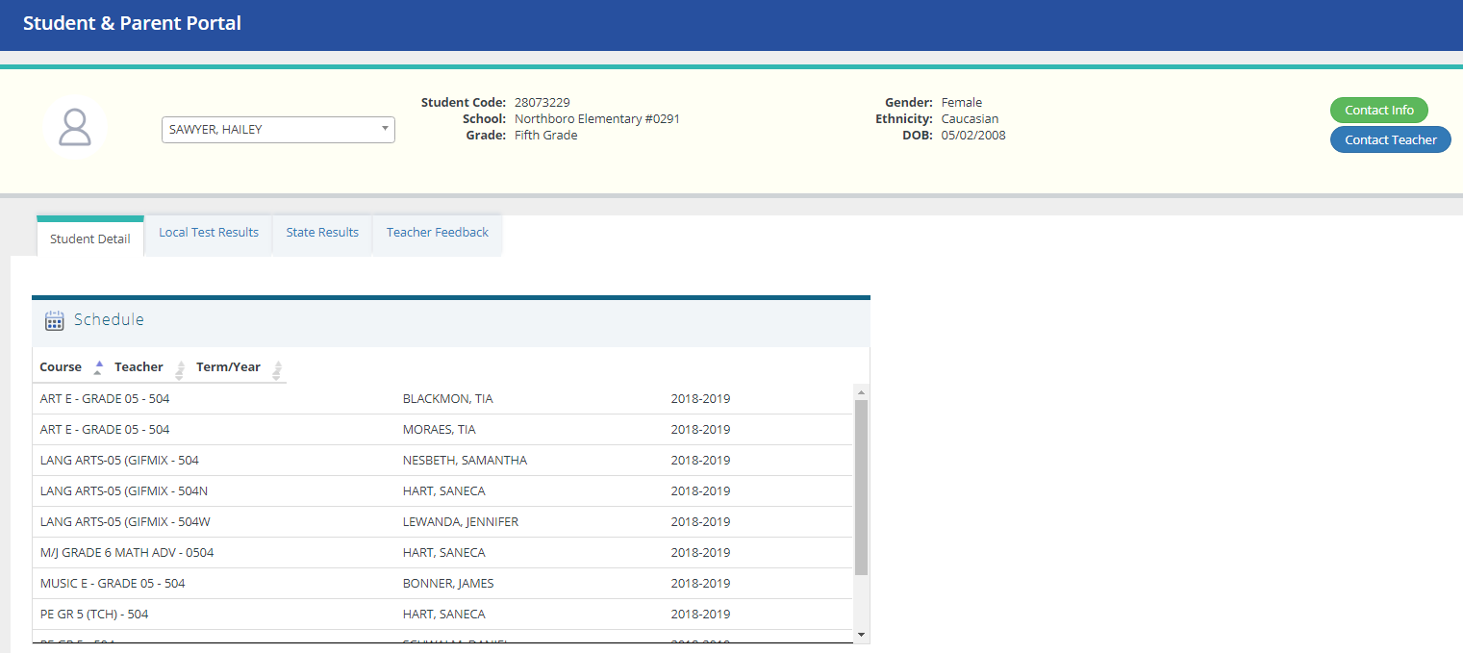
To Access Reports and Resources My Student Details Page
Student Name
Upon accessing the Student Portal, Students will be able to see their schedule and contact their teacher from the Student Detail tab
Teacher Names

Slide 7
Looking at my Local Test Results tab
To view test results from quizzes and tests, students should click on the “Local Test Results” tab. This section will display all the tests that the student has taken so far this year.
1
The course type section allows me to see which courses I have test results in alphabetical order. I can also filter so that I see only the courses that I am looking for by clicking in the “Select one or more course types” box in the upper right hand corner of this image.
2
The test name section allows me to see whether the assessment was a quiz or a test. In Palm Beach County, quizzes are labeled as an FSQ which is an abbreviation that stands for “Florida Standards Quiz” or NGSQ which stands for “Next Generation Standards Quiz” for subjects that are following Next Generation Standards. A test is labeled as a USA, which stands for Unit Standards Assessment.
3
Then I will be able to see my score and compare it to the district average for that same assessment.

Slide 8
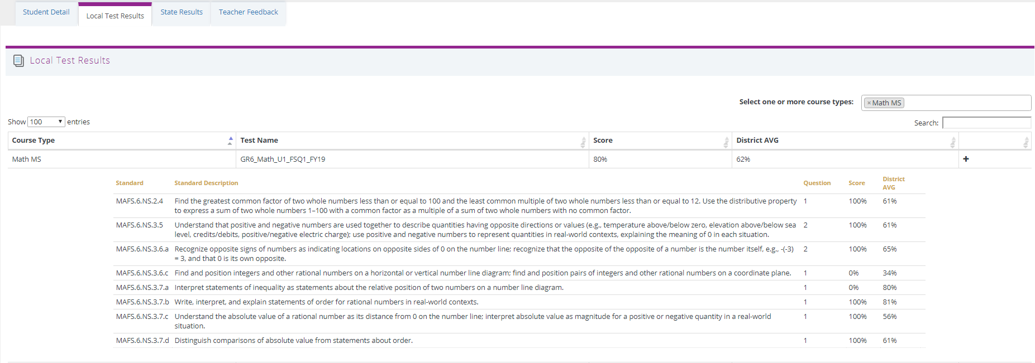
To see more information by standard
By Clicking on the + icon, a student can see the breakdown of their performance by standard.

Slide 9
Students can also see their State Test Results (Florida Standards Assessments)
These numbers represent % out of 100. Therefore a score of 73.3 means the student got 73.3% of the questions correct in the Key Ideas and details section of the FSA ELA.
1
State test results will be listed alphabetically by name and in the order they were taken. Students can see several years worth of test results even dating back to 2012-2013.
2
Currently the system is defaulted to show students the scale score that they earned along with the colored achievement band. If parents are unfamiliar with the colored achievement bands, they can click on the “Show all scores” box to the left and it will display the level next to the scale score.
3
Students can also click on the plus icon to expand the test results to show the reporting categories that each test encompassed and how the student performed in each category.

Slide 10
Logging out of the Student Reporting Portal
1
Log out through your Student Details page
2
Click on the downward triangle (pictured below) next to your name and choose “Logout.”
Student Name
Student Name
It is very important to always remember to log out of your Student Reporting Portal, especially when utilizing a shared or public computer. Since most computers utilize cookies or markers in the cache to enable them to work faster, students need to remember to log out in order to protect their confidentiality. Simply closing a tab or window is not sufficient.

