Slide 1
Unit 11 Gallery Walk

Slide 2
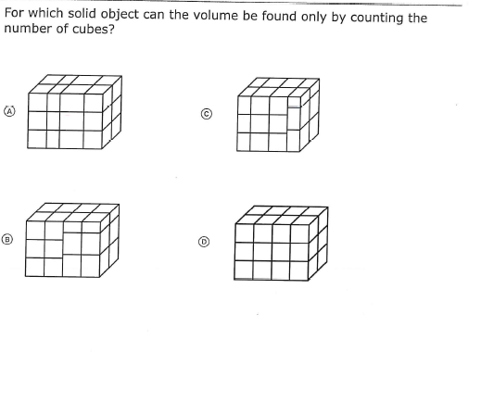
1.
Notes:
D

Slide 3
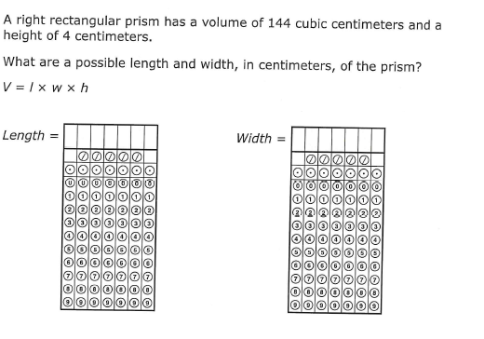
2.

Slide 4
3.
Notes:
T
F
F

Slide 5
4.
Notes:
6x4x4=96
9x5x4=180
276

Slide 6
5.
Notes:
64

Slide 7
6.
Notes:
a.1
b.30
c.3
d.90

Slide 8
7.
Notes:
A

Slide 9
8.
Notes:
C E

Slide 10
9.
A fish tank is shaped like a rectangular prism. It is 5 feet long and 4 feet wide. The amount of water that is needed to fill half of the tank is 80 cubic feet.
What is the height of the fish tank?
Notes:
8

