Slide 1
Unit 7 Gallery Walk

Slide 2
Notes:
1 & 5/6

Slide 3
2.
Notes:
3

Slide 4
3.
Notes:
2 & 17/18

Slide 5
4.
Notes:
B

Slide 6
5.
Notes:
B

Slide 7
6.
Notes:
B

Slide 8
7.
Notes:
B,D,E

Slide 9
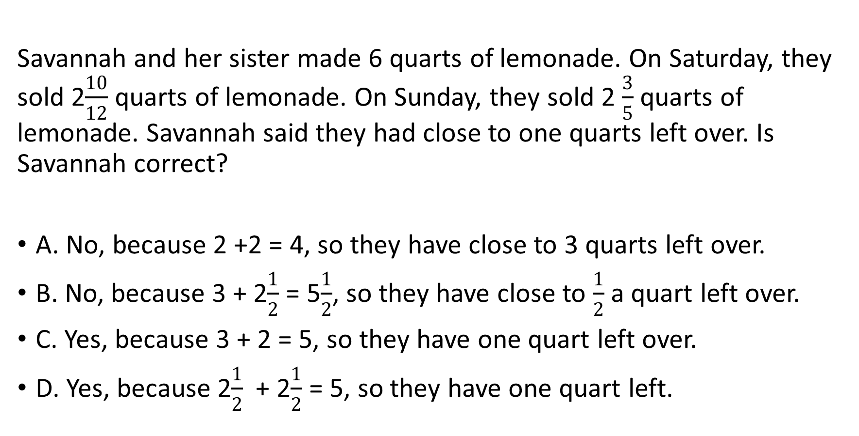
8.
Savannah and her sister made 6 quarts of lemonade. On Saturday, they sold 2$\frac{10}{12}$ quarts of lemonade. On Sunday, they sold 2 $\frac{3}{5}$ quarts of lemonade. Savannah said they had close to one quarts left over. Is Savannah correct?
A. No, because 2 +2 = 4, so they have close to 3 quarts left over.
B. No, because 3 + 2$\frac{1}{2}$ = 5$\frac{1}{2}$, so they have close to $\frac{1}{2}$ a quart left over.
C. Yes, because 3 + 2 = 5, so they have one quart left over.
D. Yes, because 2$\frac{1}{2}$ + 2$\frac{1}{2}$ = 5, so they have one quart left.
Notes:
B

