Slide 1
Mrs. Murphy
MATH AND SCIENCE

Slide 2
Rules
1. Be respectful
2. Be responsible.
3. Be kind.
4. Be ready to learn.

Slide 3
Expectations:
Good attitude
Manners
Take pride in work
Sense of humor
Complete all required work to the best of ability
100% effort

Slide 4
Rewards
Educational Computer time
Free Reading time

Slide 5
Consequences:
Reminder
Parent Contact (email or phone call)
Write up
Referral to the office

Slide 6
Disruptive and/ or unacceptable Behavior:
Excessive talking
Out of seat or area
Insubordination (talking back to teacher)
Failure to follow directions
Horseplay
Inappropriate comment/language

Slide 7
Go Math Curriculum
Whole group instruction
Small group instruction
Independent assignments
Real-World Math application

Slide 8
STEMscopes
Science is a hands-on experience
Weekly labs
Quizzes & Unit Tests
STEMscopes lessons will be assigned for review at home

Slide 9
Extended Activity
Extended learning will be assigned almost every night to review the Math lesson from that day.
Science will be on an as needed basis.
45 minutes of i-ready needs to completed each week for both Math and ELA.
Your child’s password will be given to them in their agenda.

Slide 10
Classroom Donations
Personal hygiene items
Tissue
Hand sanitizer, baby wipes, or wet wipes
Enhancement materials
(to support classroom learning)
Whiteboards
Whiteboard markers and erasers
Lined Paper

Slide 11
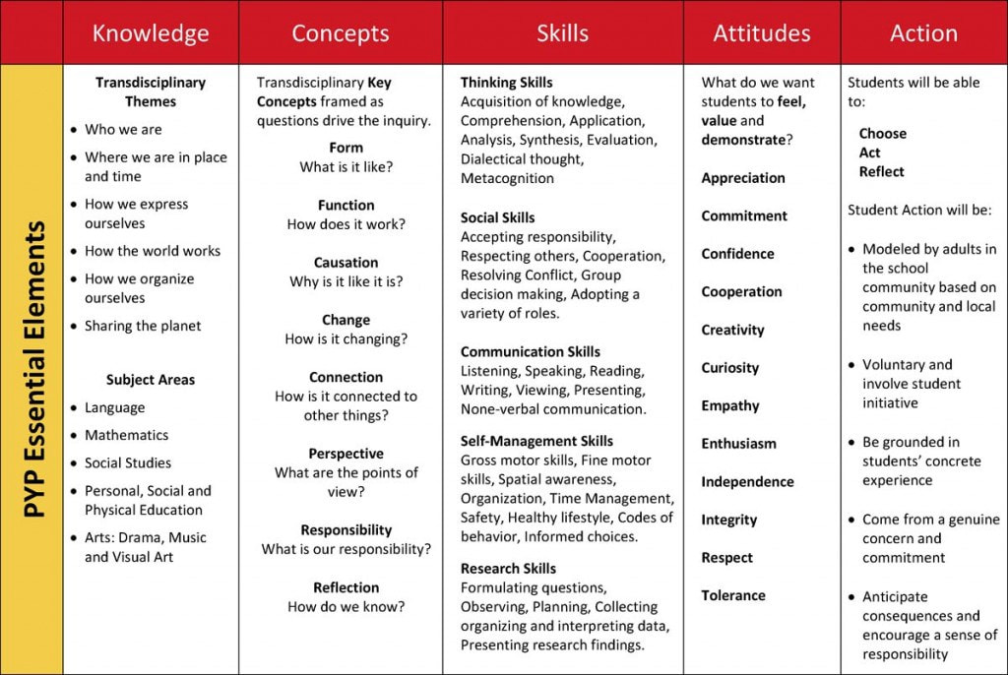
What is the IB Program?
The International Baccalaureate® (IB) Primary Years Program (PYP) is a curriculum framework designed for students aged 3 to 12. It prepares students for the intellectual challenges of further education and their future careers, focusing on the development of the whole child as an inquirer, both in the classroom and in the world outside.
The curriculum is centered through the IB PYP 5 Essential Elements.

Slide 12
What you will see in your students classroom:
Central Ideas – a “Big Idea” for a 6 week unit of study aligned through Science and Social Studies
Lines of Inquiry – objectives aligned through Science and Social Studies to guide inquiry through the 6 week unit
Learner Profile – attributes valued by the IB of students that “can help individuals and groups become responsible members of local, national and global communities”.
Inquirers, thinkers, communicators, knowledgeable, risk takers, principled, caring, open-minded, balanced, and reflective.
Action Cycle
Inquiry based lessons

Slide 13
Want to know more about the ib pyp?
Please visit the IBO website: www.ibo.org
Franklin Academy Boynton Beach’s IB Weebly: www.fa-ib.weebly.com
Attend Curriculum Nights and IB Nights when announced.

Slide 14
Communication:
Please check our website weekly. We will keep you up-to-date on all classroom events, as well as school-wide announcements & programs you may be interested in attending. All test dates will also be posted in advance so your child can prepare.
Without open lines of communication between parent and teacher, we cannot do our job effectively. If you need to contact us at any time, please don’t hesitate to do so via email, phone, or a note in your child’s planner.

Slide 15
Contact Info
E-mail: murphy.amber@franklin-academy.org
(Best way to reach me)
Website:http://fa-murphy.weebly.com
School number: (561) 767-4700

